Slide 1

BLOOD BANK APP
JIMIT PANDITPUTRA(111915082)
SARTHAK JAIN(111915114)
SHREY DANGAYACH(111916045)
PASUPUNRI BHARATH KUMAR(111915083)
GROUP 35

Slide 2
OUTLINE
Introduction
Database Design
Class Diagram
Use Case
State Diagram
Conclusion

Slide 3
INTRODUCTION
The main aim of this project is to save lives of people by providing blood.
This project is developed by three user perspectives i.e. staff, volunteer donors and seekers.
This application reduces the time to a greater extent that is searching for the required blood through online mode.
This app is based in java and uses the NetBeans IDE using the JDBC concept connecting it to the oracle database.

Slide 4
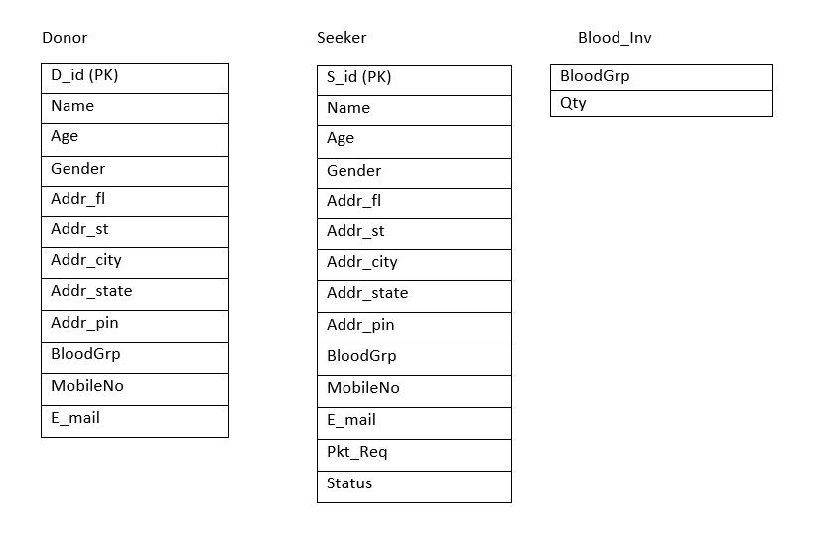
DATABASE DESIGN
The information that is available in our app is shown in the form of three table in the database

Slide 5
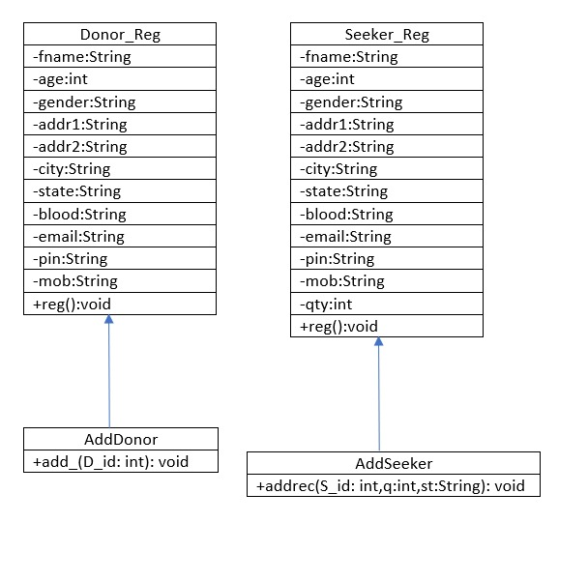
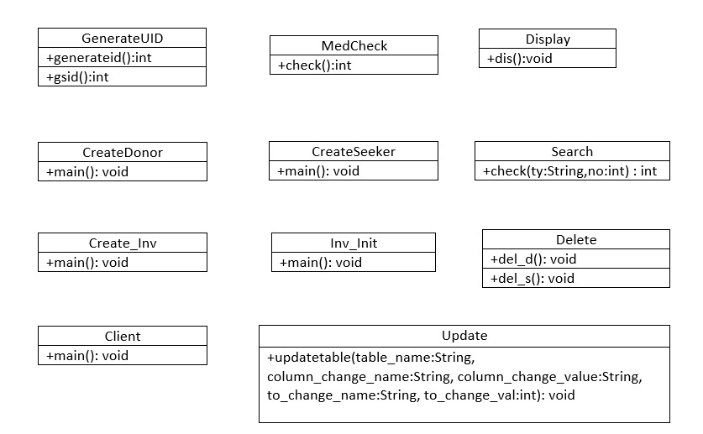
CLASS DIAGRAM

Slide 6
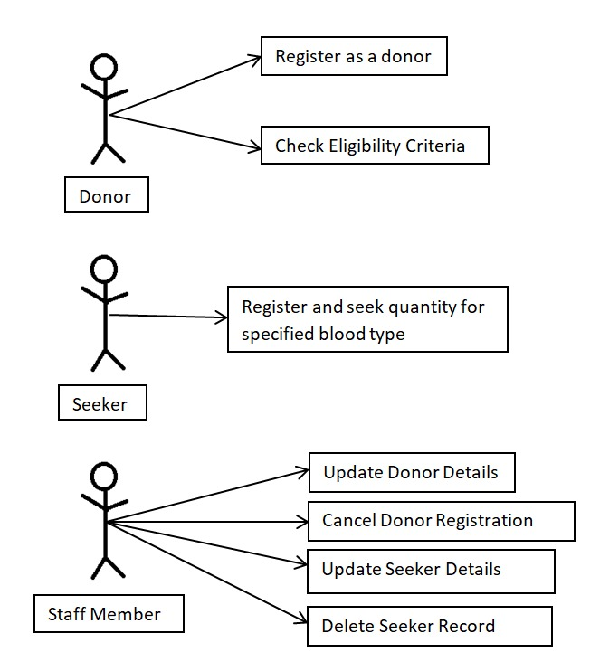
USE CASE
This picture depicts the various actions than can be performed by the three types users.

Slide 7
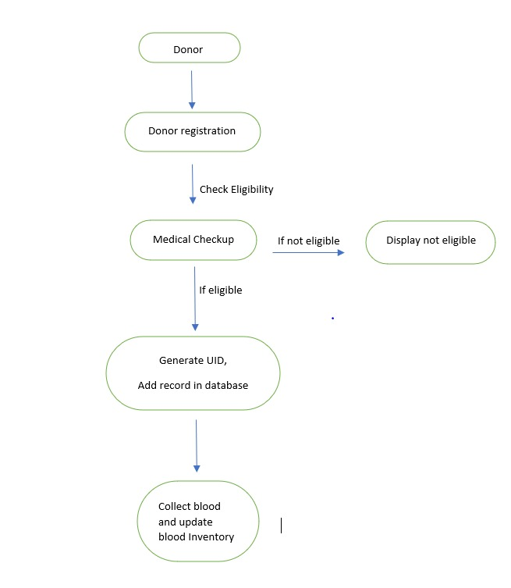
STATE DIAGRAM
This flow chart represents the action of steps that can be performed by the donor

Slide 8
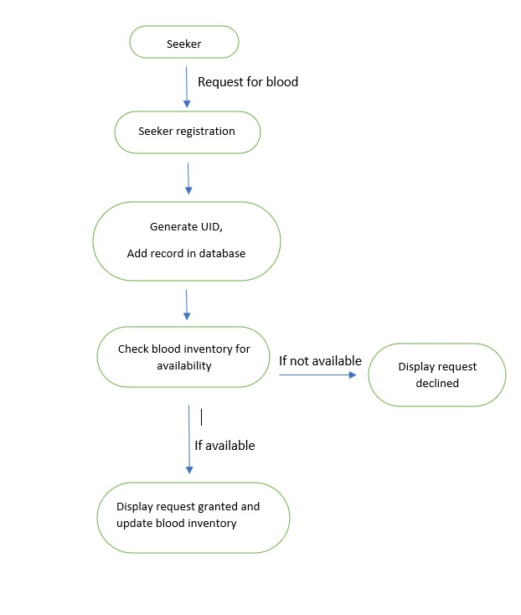
STATE DIAGRAM
This flow chart represents the action of steps that can be performed by the seeker

Slide 9
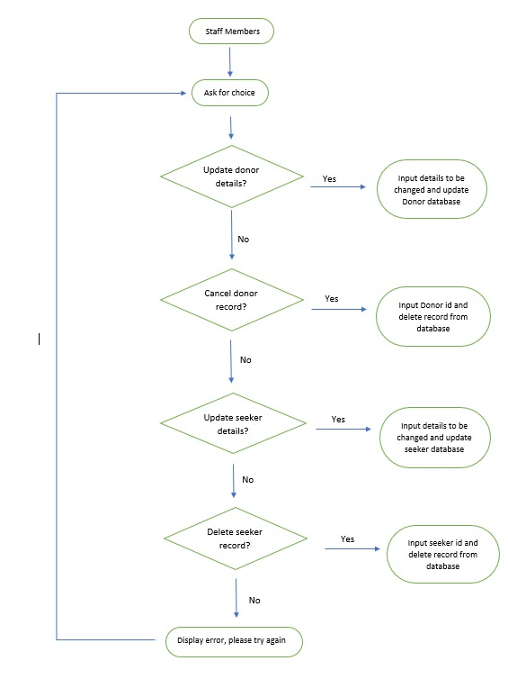
STATE DIAGRAM
This flow chart represents the action of steps that can be performed by the staff member

Slide 10
CONCLUSION
Through this application we can fulfil our objective of giving back to the society.
This app will prove to be beneficial in emergency situations and time saving act which might help in saving a persons life.
Through this app we can maintain a database of all current and future beneficiaries and the total units of packets of various blood types.

Slide 11
THANK YOU

